Slide 1
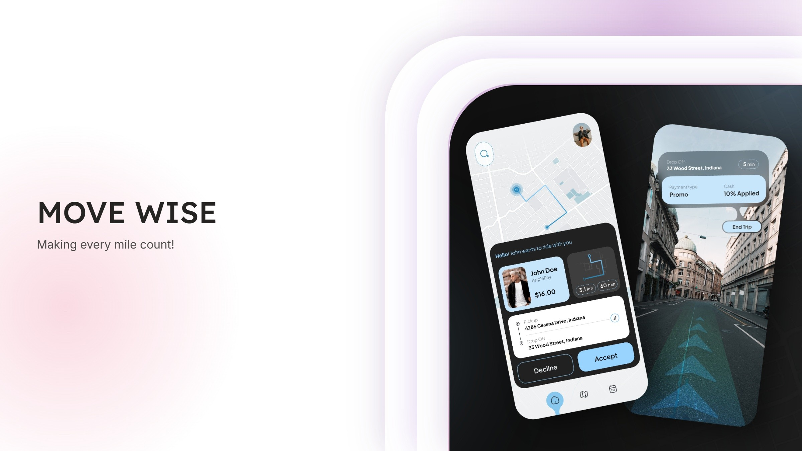

Slide 2
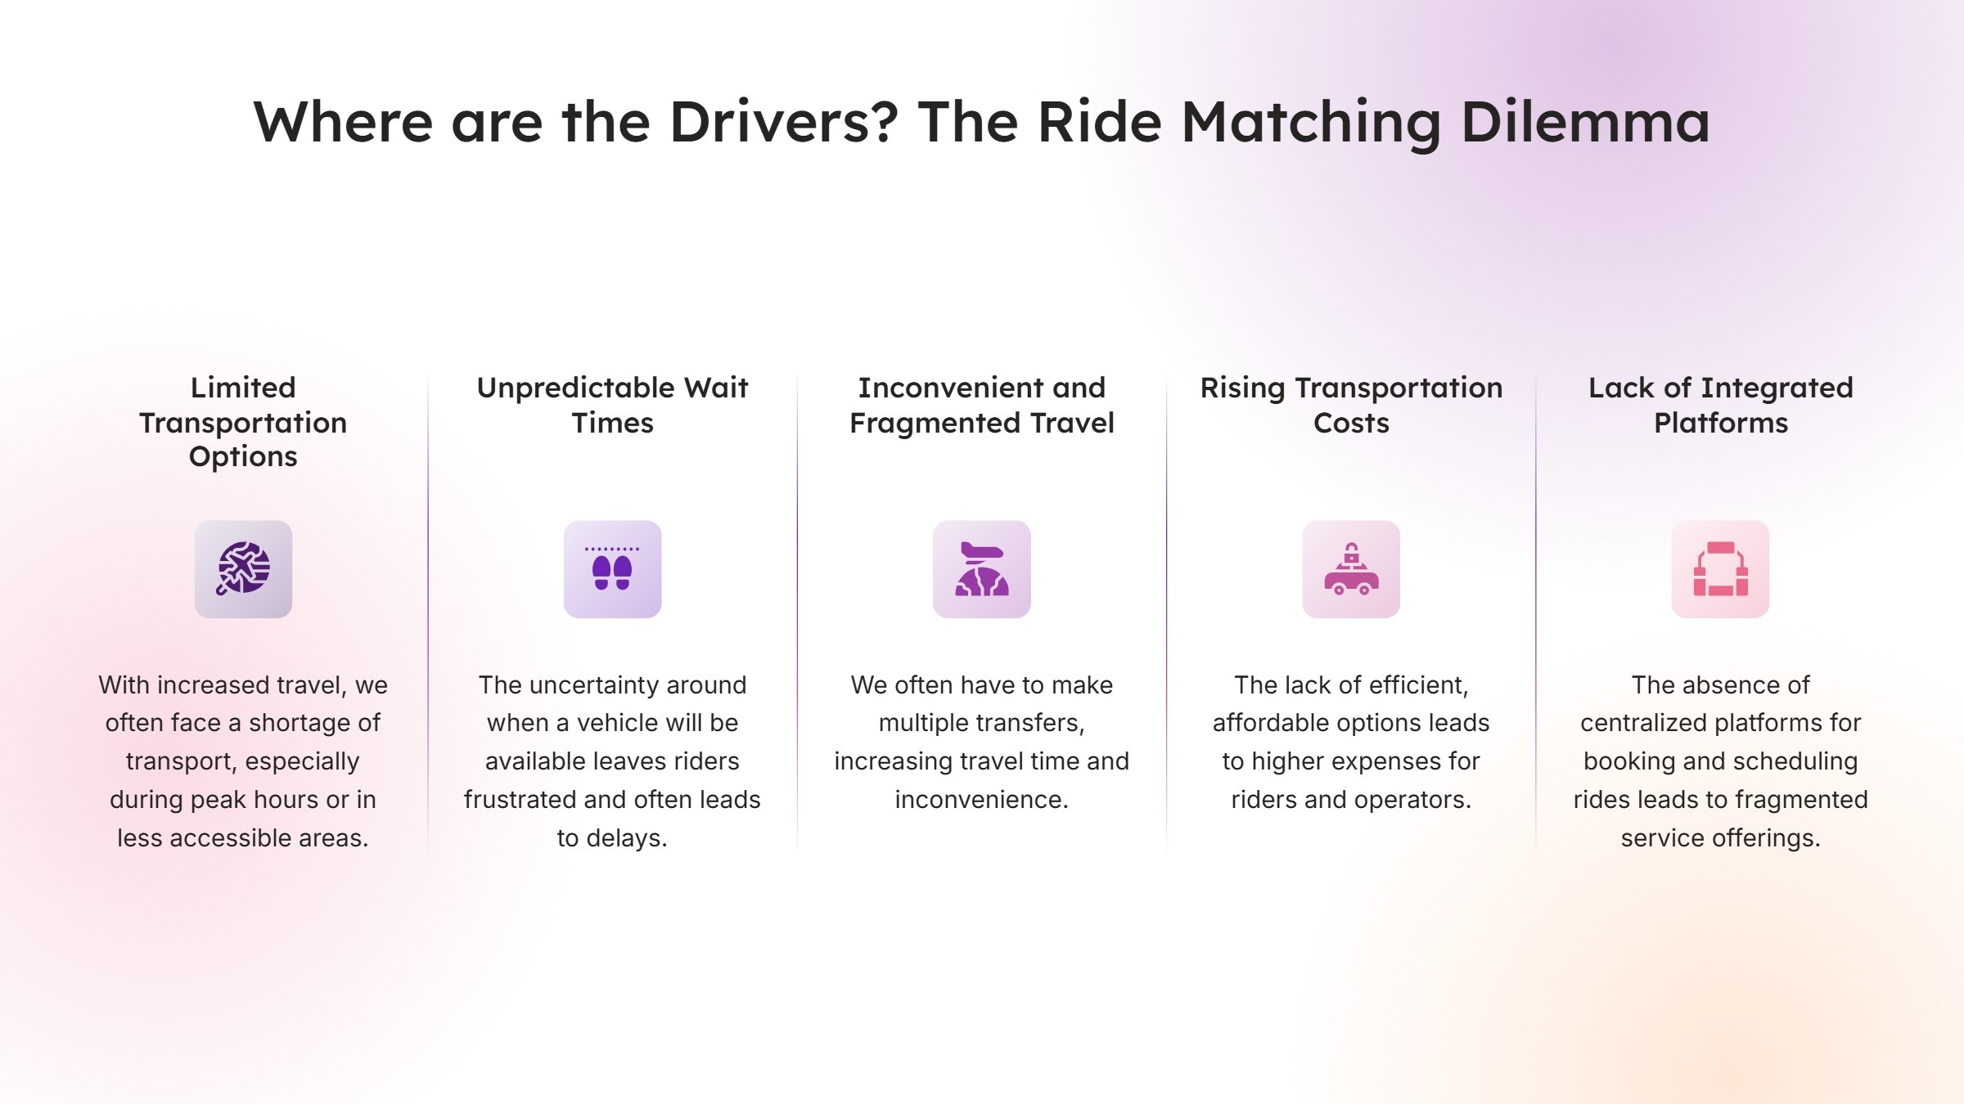

Slide 3
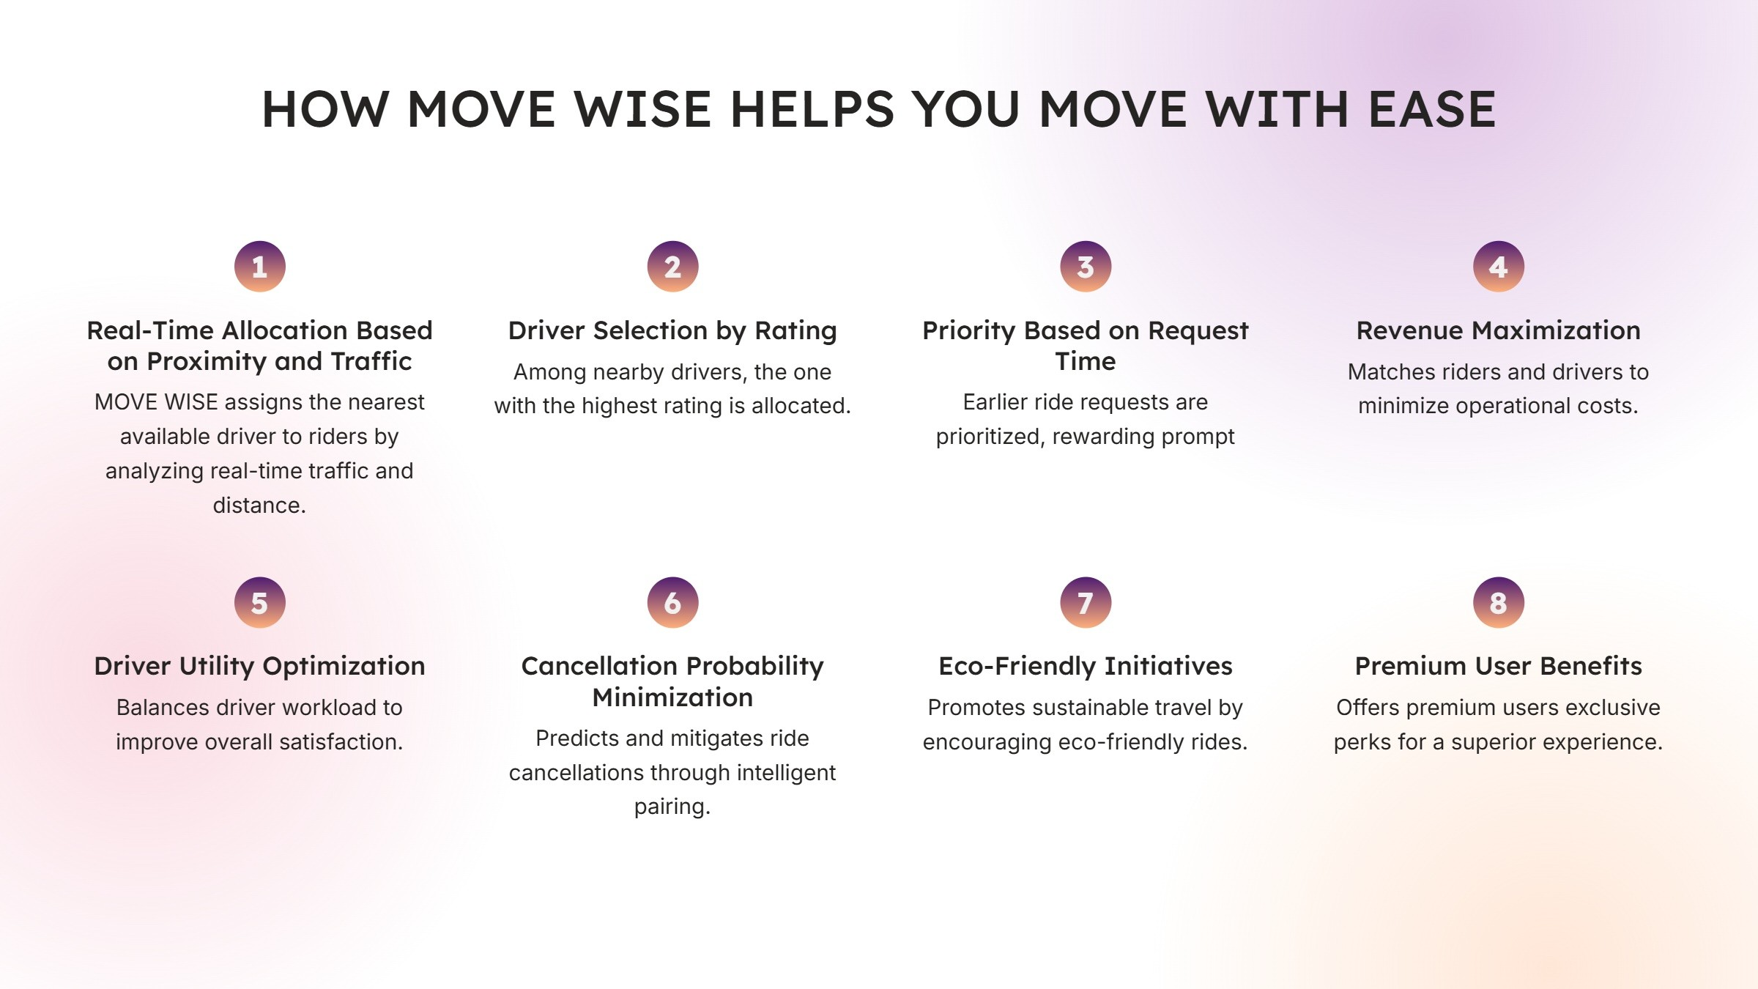

Slide 4
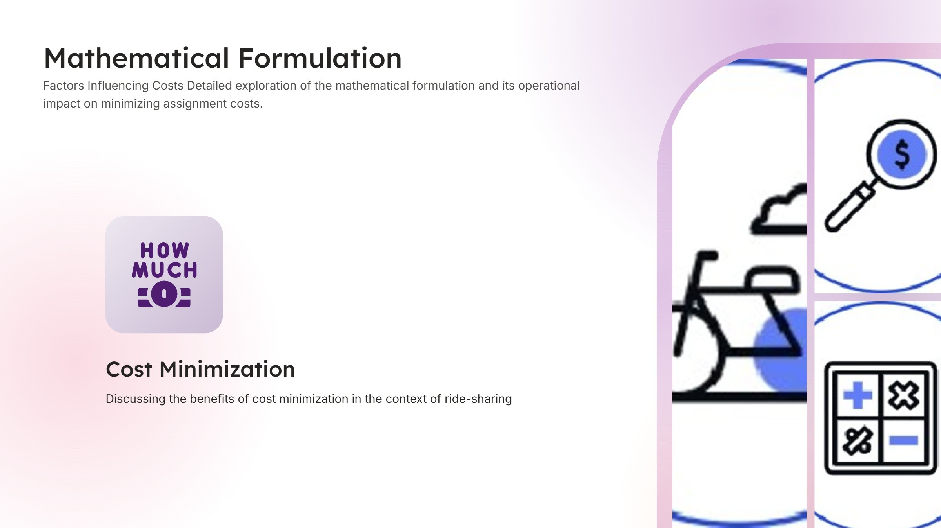

Slide 5
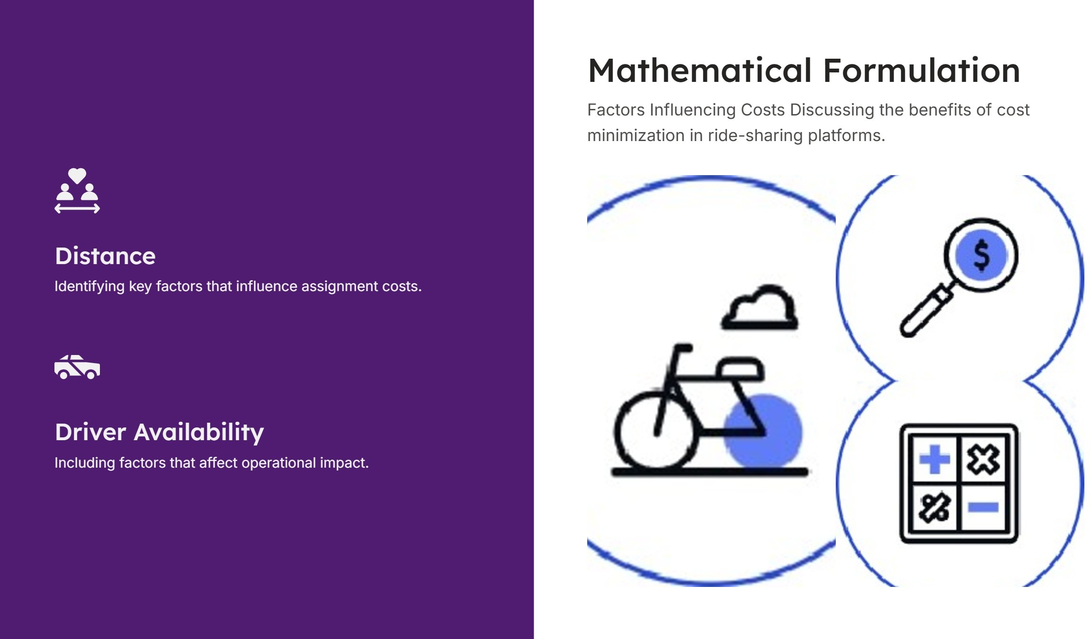

Slide 6



Promoting Eco- Friendly Rides and Subscription Users
Environmental considerations in ride allocation
Incorporating eco-friendly
c riteria into the process of ride allocation to minimize the
environmental impact.
Benefits of eco- friendly policies
Incentivizing subscription user engagement
Implementing eco—friend ly policies can enhance company branding and foster customer loyalty.
Strategies to Enhance Eco—Friendliness and User Engagement
Developing strategies that encourage subscr iption users to actively participote in eco- friend ly ride allocation.

Slide 7



Mathematical Formulation
Detailed exploration of the mathematical formulation and its operational impact on minimizing assignment costs.
MinimizingAssignment
Factors Influencing Costs
Identifying key factors that influence assignment costs, including distance and driver availability.
Costs
Exploring Elective Cost Reduction S†ra†egies
Benefits in Ride-Sharing
Discussing the benefits of cost minimization in †he context of ride-sharing plolforms.

Slide 8
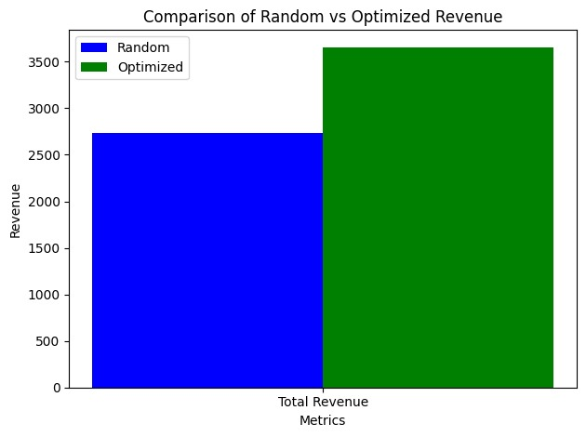
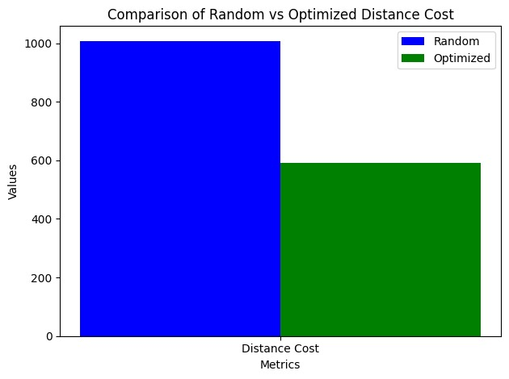
COMPARISON: RANDOM VS OPTIMIZED ALLOCATION
RANDOM : THE REVENUE IS NOT AS HIGH AS THE RESOURCES ARE NOT FULLY UTILIZED.
OPTIMIZED:
REVENUE IS MAXIMIZED IN THIS CASE AND ALL DRIVERS AND RIDERS ARE SATISFIED
RANDOM:
COST S INCREASE AS THE DISTANCES AND DRIVER ALLOCATION IS NOT OPTIMIZED
OPTIMIZED:
COSTS ARE OPTIMIZED AND RESOURCES ARE UTILIZED PROPERLY.

